Slide 1
University of Regina
STUDENT HUB
MILESTONE 3

Slide 2

The Blaugranes
Anirudh, Gift, Kyle, Ufuoma

Slide 3

About Project
Social Networking website for students of University of Regina
STUDENT
Know what's happening at UofR
HUB
Join the conversation and express your opinion

Slide 4
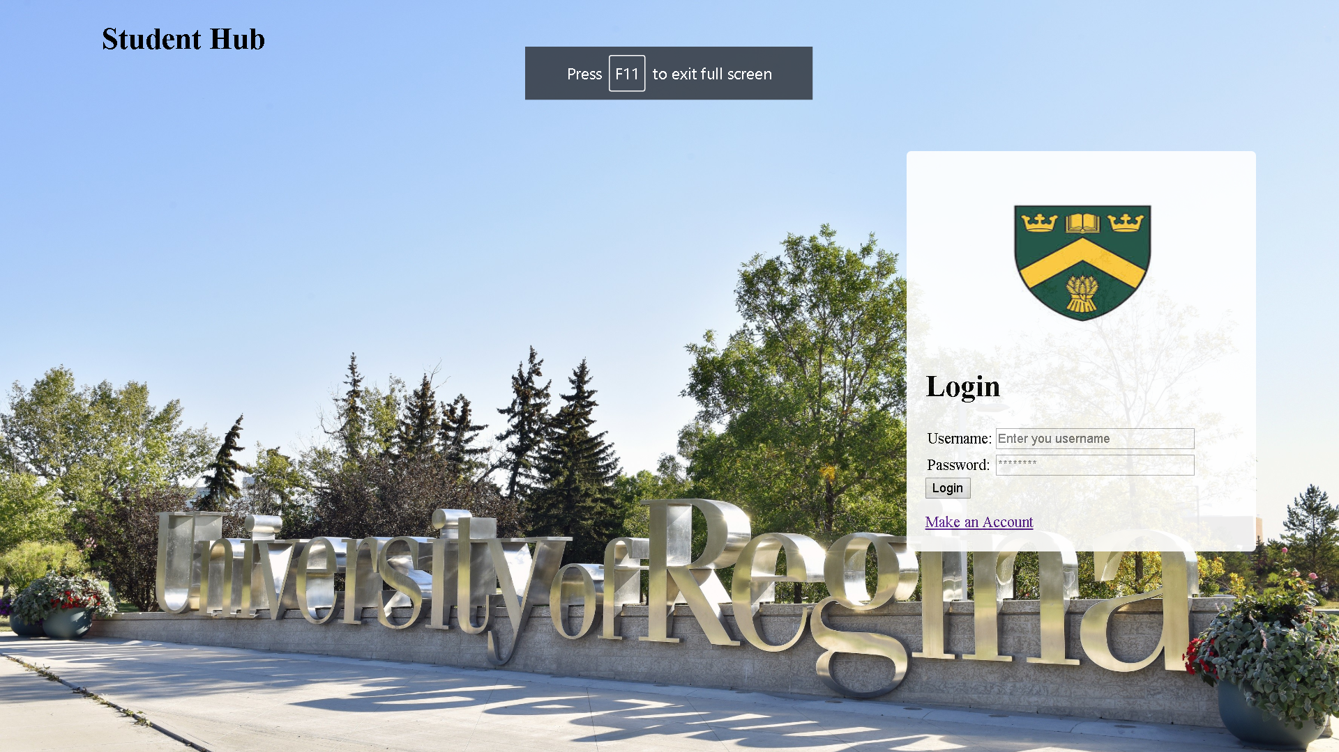
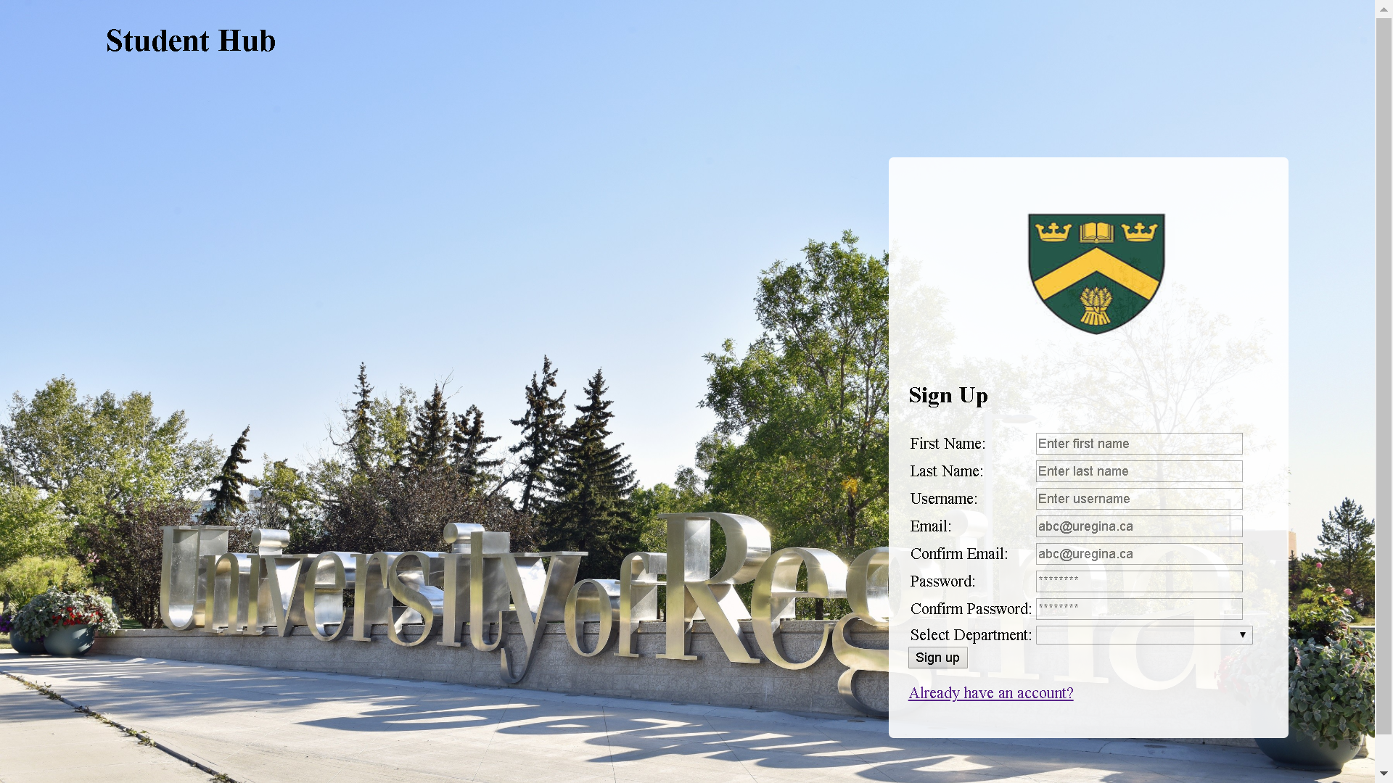
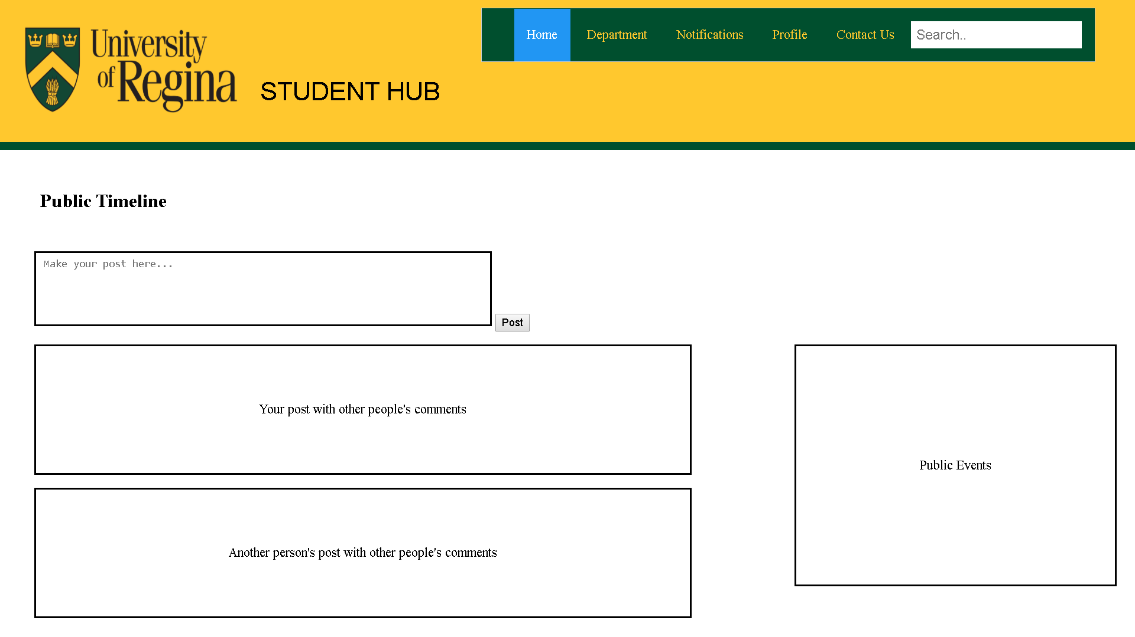
Interface
Login Page
Registration page
Main page

Slide 5

Website Mockup
STUDENT
HUB

Slide 6
DISCUSSING MVP-1
Was our team successful in mapping out our envisioned MVP-1?
❔
Why not?
</
Code
NO.
-Could not achieve posting threads
-Lack of certain skills
-Even though MVP-1 was not completely successful, we could still deliver the idea of our project
-code is significantly clean
-<style> for every page can be made more clean by creating an external CSS file, instead of internal style

Slide 7
Changes
Project Vision
Lo-fi
Updated UML class diagram

Slide 8
About Us
You can put your great title here
HUB
STUDENT
Old Project Vision
New project Vision
-It is a fun and engaging way of learning
-it builds a healthy relationship between students and improves collaboration.
-Connect UofR students
-Explore UofR student life
-Join UofR community
-Raise your voice

Slide 9
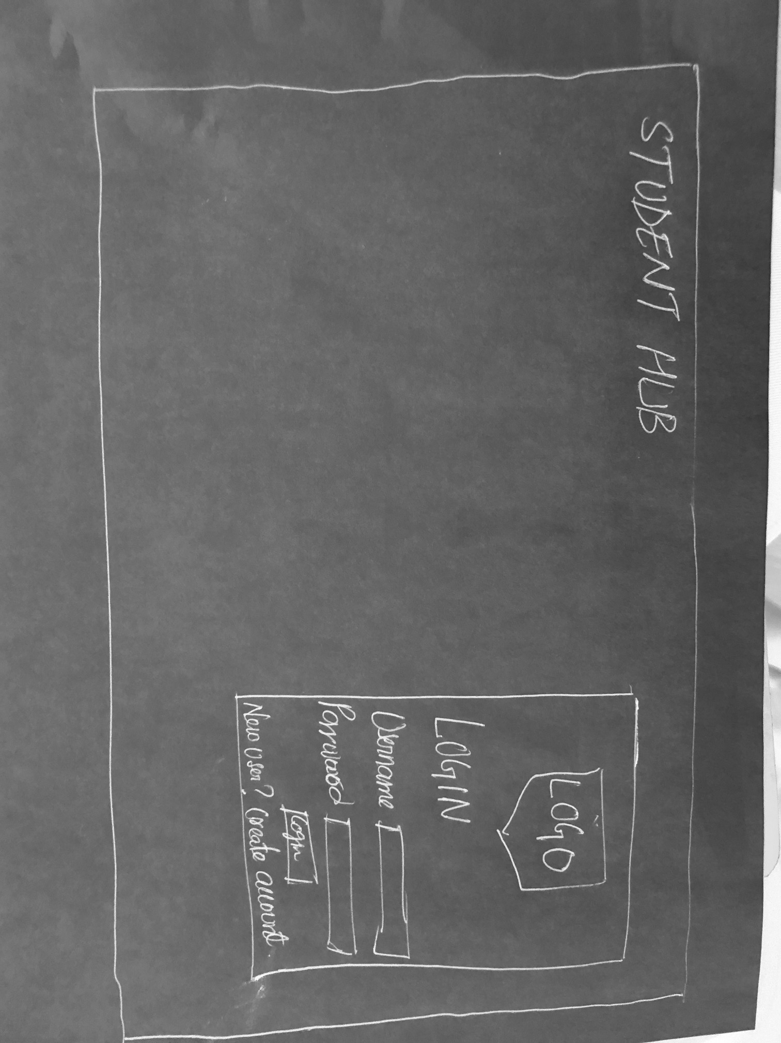
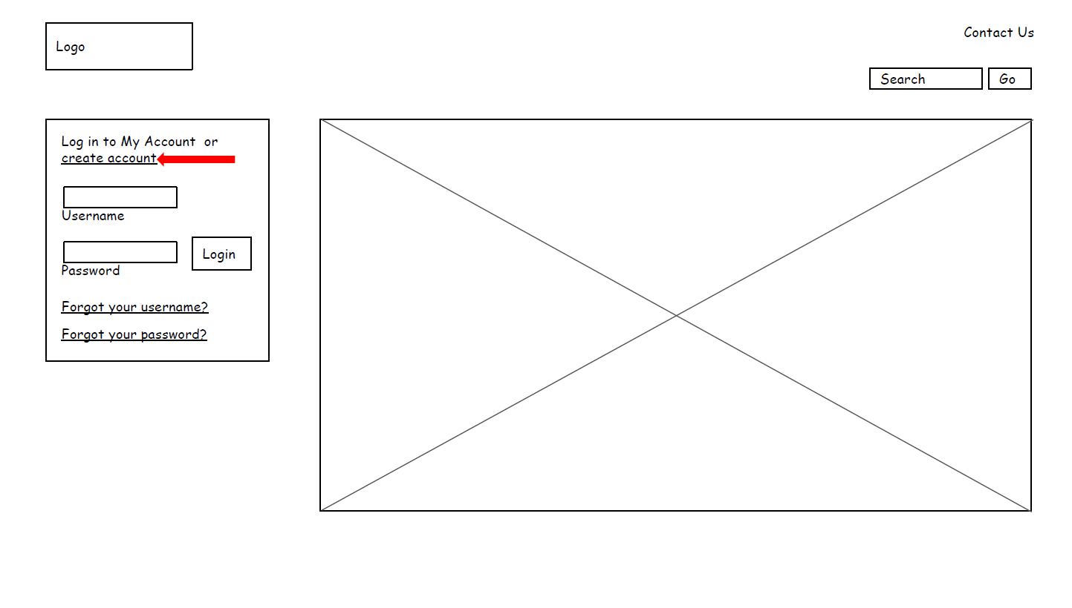

Slide 10
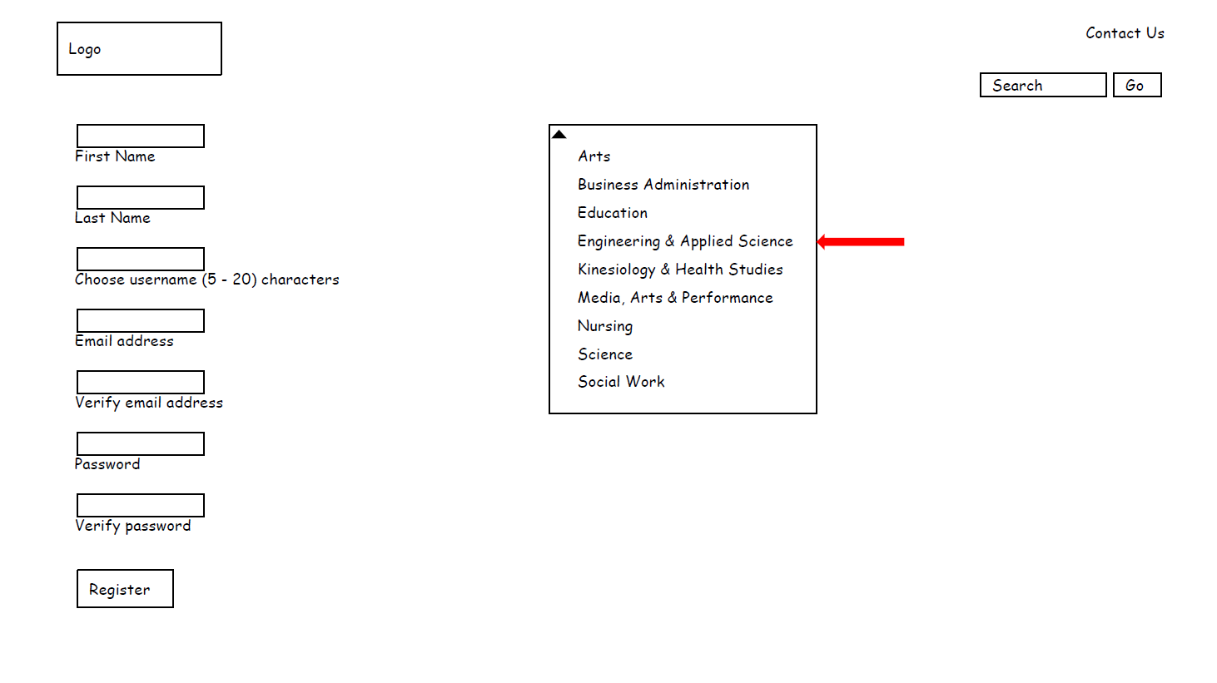
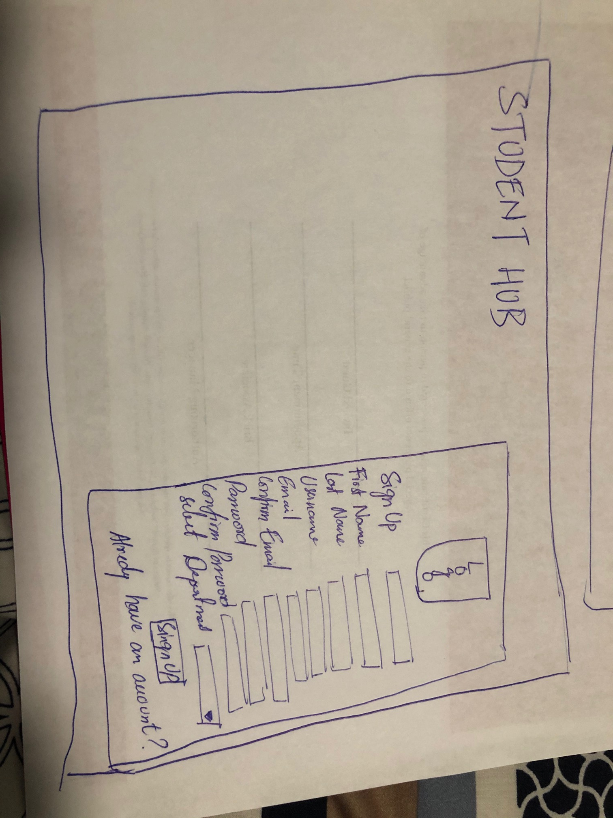

Slide 11
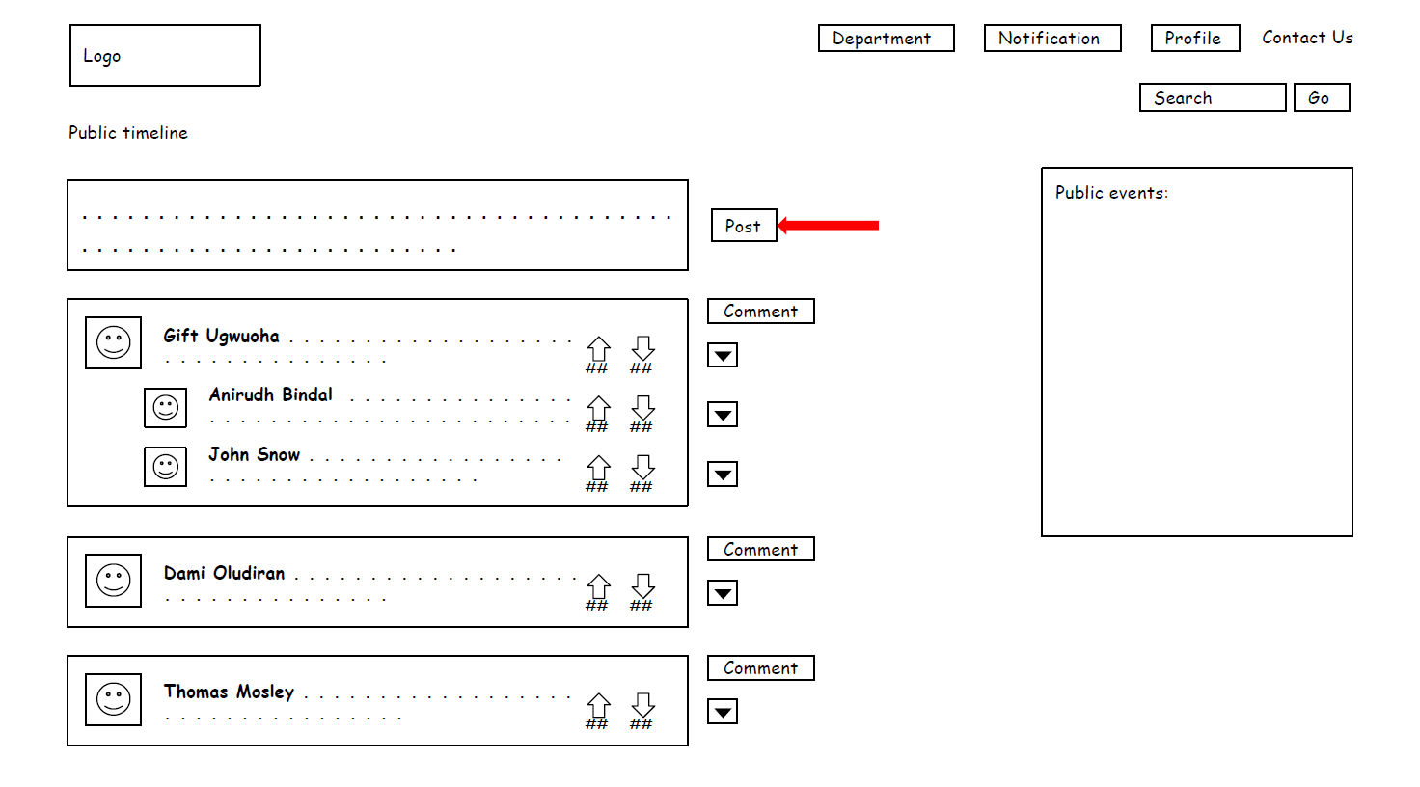
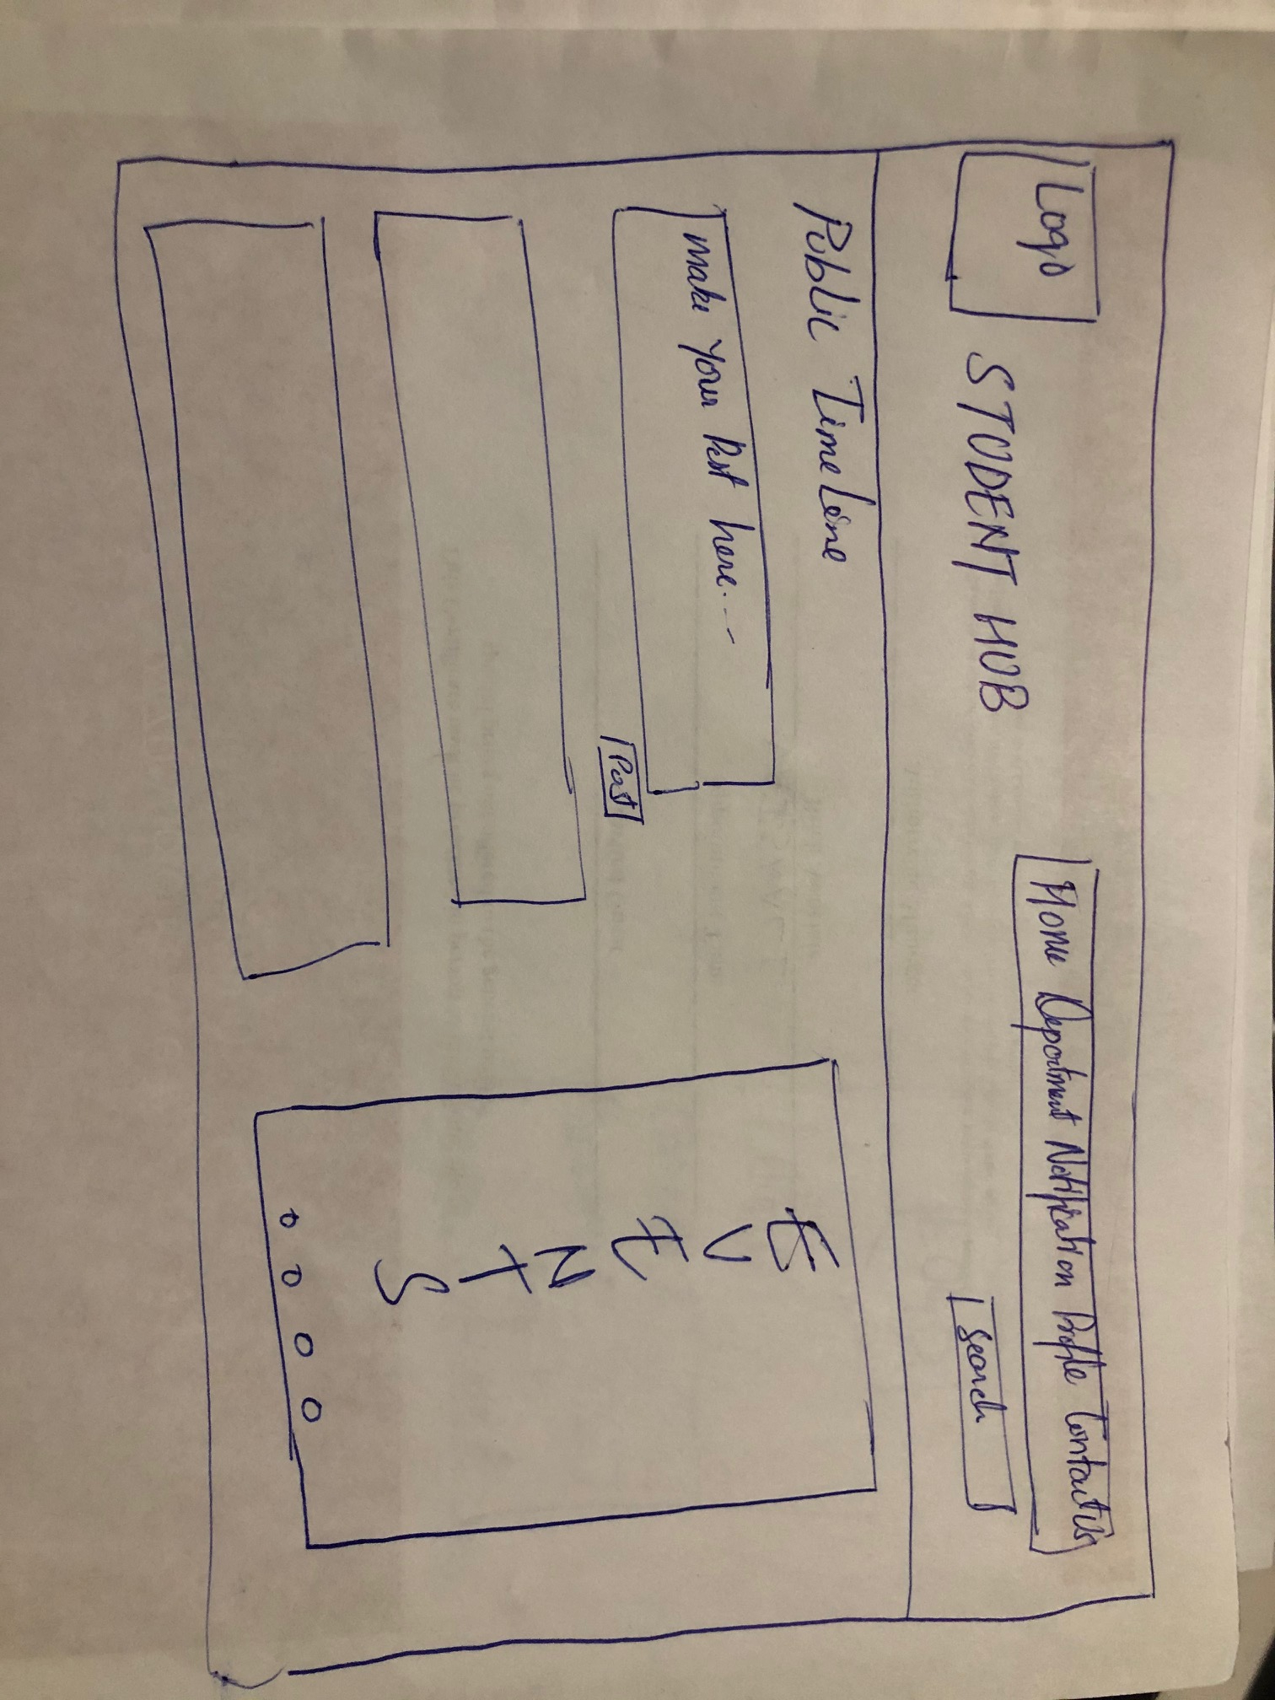

Slide 12
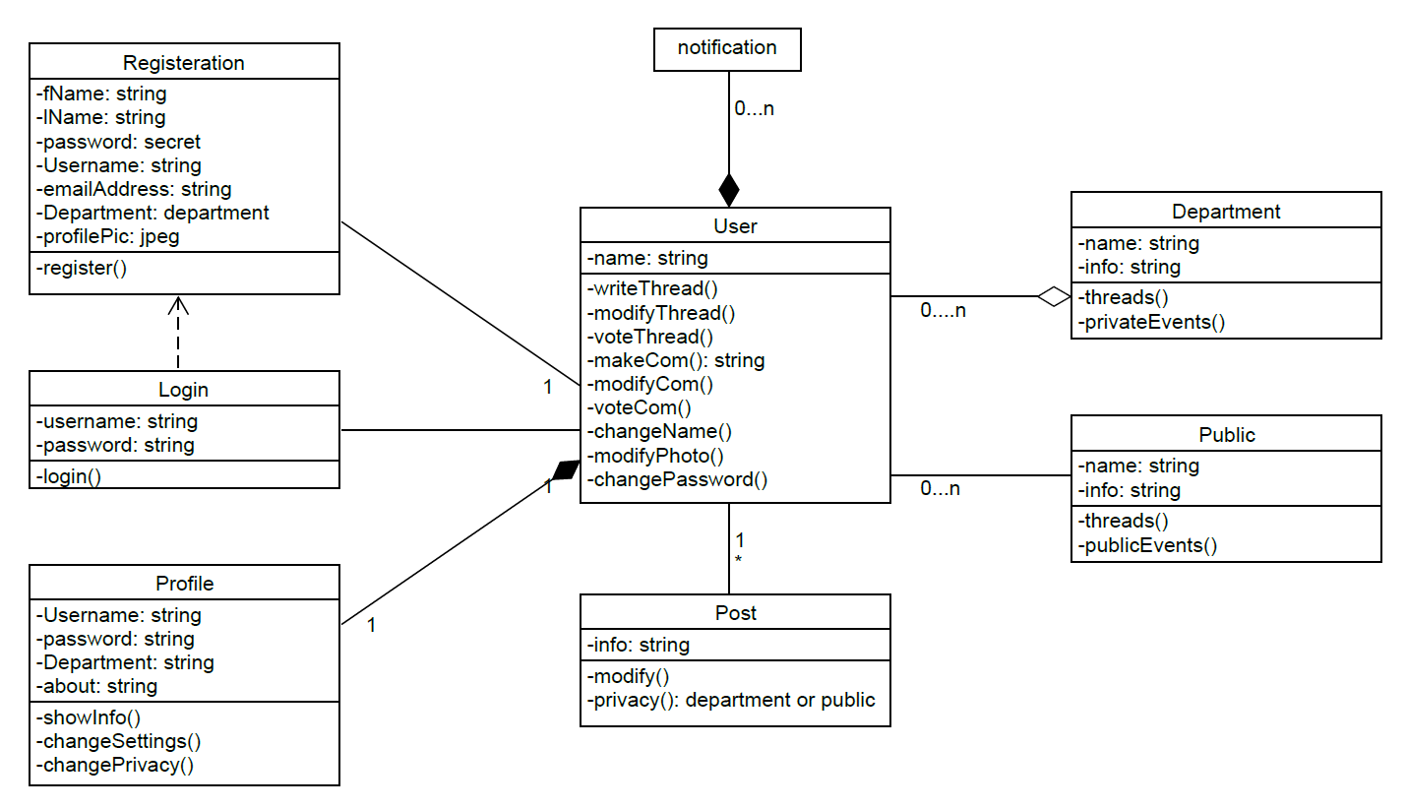

Slide 13
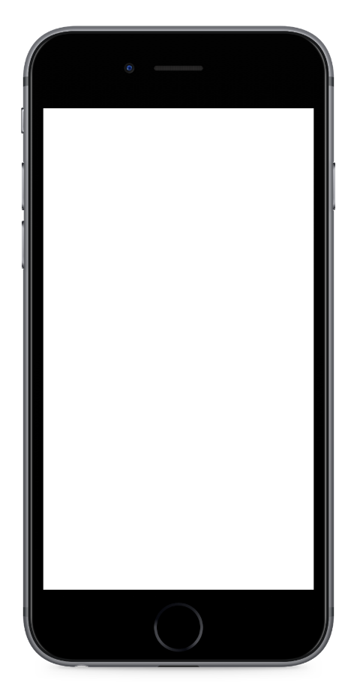
KANBAN
New Meetings
Blaugranes
Changes in Lo-fi, Vision, New UML diagram, updated FRD
Codes

Slide 14
Final MVP
1
2
1
2
GOAL
Is it Doable?
Fully functional website with Updating timeline
Yes
3
4
4
3
Help
Barriers to success
We are looking for Programmers are welcome to help us.
Lack of programming skills

Slide 15
Group Reflection
•How did you feel about this milestone? What did you like about it? What did you dislike?
-It helped us differentiate between imagination outcomes and actual outcomes.
•What did you learn about yourself as you collaborated and worked through this milestone?
-We learned about individual skills
•How will you use what you have learned going forward?
-Each team member will focus on specific tasks for accuracy and efficiency
•What “stuff & things” related to this milestone would you want help with?
-Programming

Slide 16

Thank You
For your attention!

